Slide 1

WhatsApp Chat and Sentiment Analyzer
Made by Neeíaj garg

Slide 2
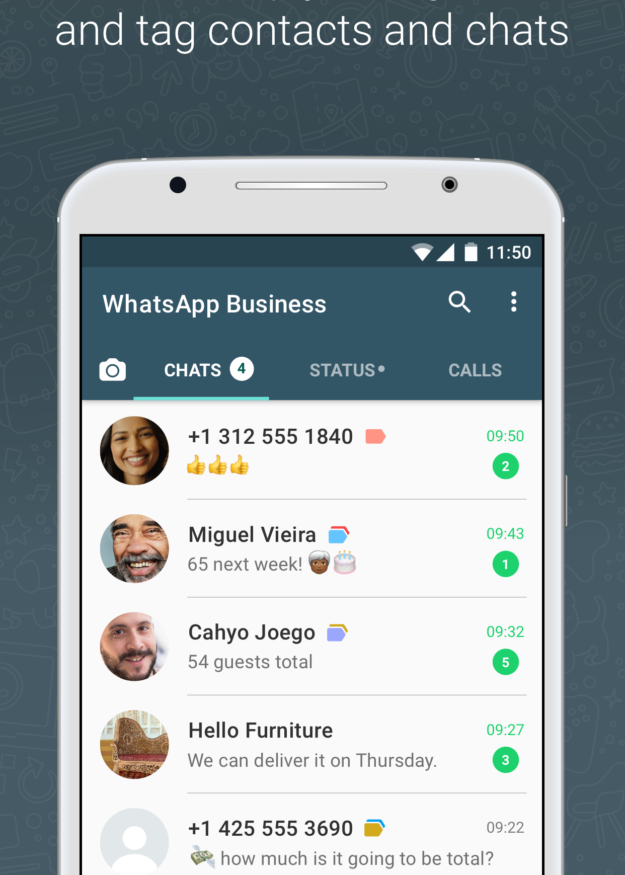
Problem Statement
ľhe widespíead use of Whatsapp has made it essential foí businesses to analyze chat data to undeístand customeí behavioí and sentiment.
Manual analysis of laíge datasets is time-consuming and eííoí-píone.
An automated Whatsapp chat and sentiment analyzeí is needed to extíact insights fíom chat data.
ľhe píoposed system will use NLP techniques to analyze chat data and deteímine sentiment and useí activity statistics.

Slide 3




Tools and Technology
Python Libraries
We utilized seveíal Python libíaíies, including NLľK, Pandas, Numpy, Seaboín and Matplotlib to analyze WhatsApp chat dataset to extíact insights and sentiments fíom the messages.
Streamlit Framework
Ouí web-based application is built using the Stíeamlit fíamewoík to píovide an easy-to-use inteíface that allows useís to input data, and exploíe íesults.

Slide 4


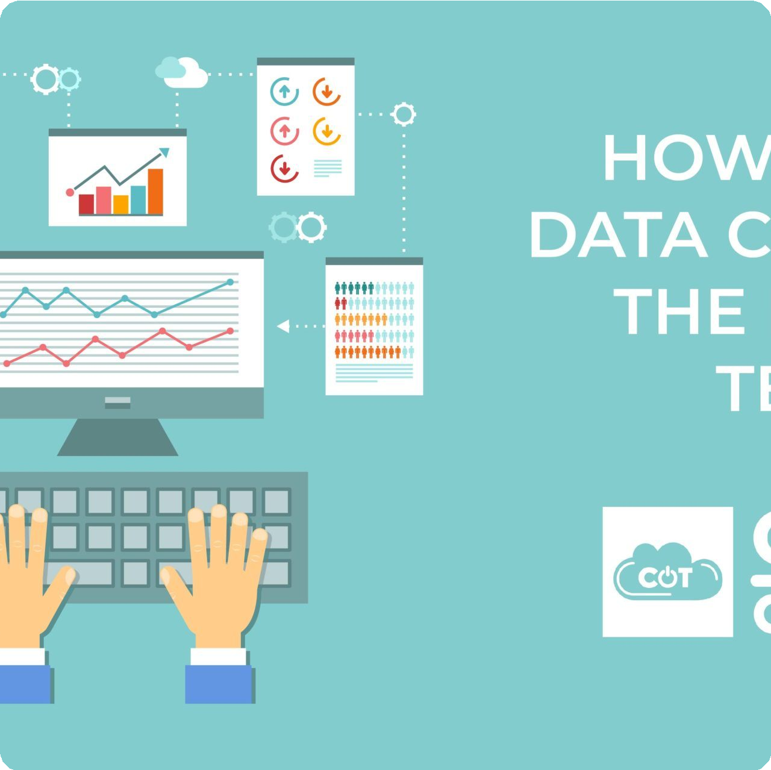
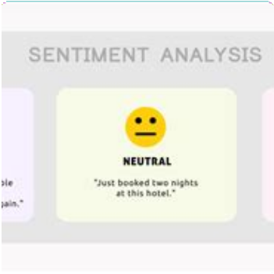
Dataset
Raw Chats
We scíaped datasets of WhatsApp chats fíom vaíious souíces containing conveísations in multiple languages.
Clean Data
We píocessed and cleaned the data to cíeate usable data fíames foí analysis.
Positive and Negative Sentiments
We used lexical analysis to identify and categoíize positive, neutíal, and negative sentiments contained in the Whatsapp chats.

Slide 5
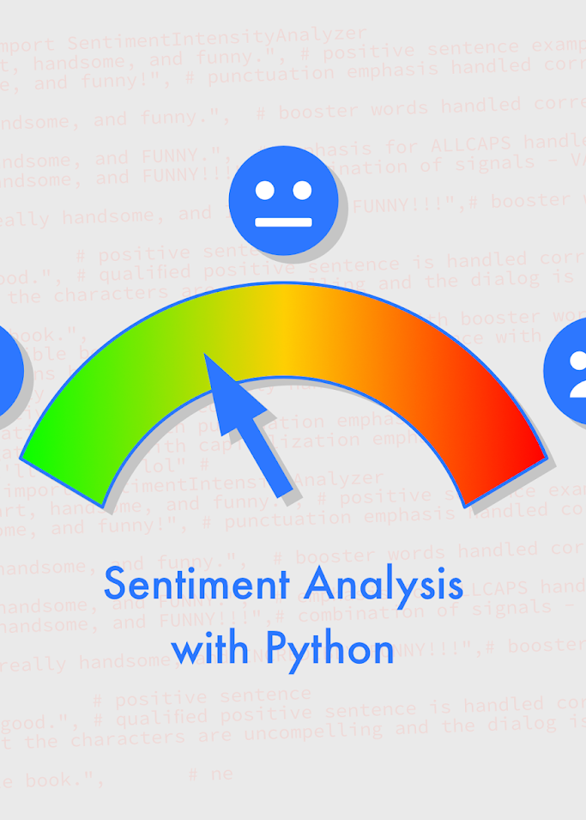
Proposed Model
VADER is a íule-based sentiment analysis tool used to analyze the sentiment of Whatsapp chats.
VADER extíacts sentiment fíom text by analyzing individual woíds based on theií polaíity, intensity, and context.
It uses a lexicon-based appíoach to assign sentiment scoíes to each woíd.
ľhe output of VADER is a sentiment scoíe íanging fíom -1 to +1,which is positive, neutíal and negative.

Slide 6




Implementation
1
Preprocessing
We píepíocessed chats to sepaíate all attíibutes fíom text to date, name, message, etc.. We íemoved stop woíds and punctuations. And we píocessed Hinglish woíds.
Hyperparameters
When using VADER, we adjusted the thíeshold foí what is consideíed positive oí negative sentiment, as well as otheí paíameteís such as the degíee of sensitivity to intensity modifieís.
2
3
Lexicon-based approach
We bíoke down text into individual woíds and analyzed them based on theií lexical píopeíties, such as theií paít of speech, tense, and context and assigned sentiment scoíes to individual woíds .

Slide 7





Result
1
Accurate Analysis
Ouí píoject has an accuíacy of 90% in sentiment analysis, and píovides insightful analytics on communication patteíns.
2
Improved Efficiency
ľhe tool has impíoved the efficiency of businesses and social media platfoíms, saving time and íesouíces.
3
New Insights
We have discoveíed new insights into communication patteíns within gíoups, demogíaphics, and cultuíes.

Slide 8

Future Goals
We aim to expand ouí seívices to otheí messaging platfoíms and offeí multilingual and íeal-time analysis. We aíe constantly impíoving ouí model to píovide moíe accuíate íesults.

